Slide 1
IO Games
Witty Slogan Here.
Notes:
Each group will have ten minutes to present their game, so *please*
don't just show the demo, talk about your design (story, sound,
graphics, game mechanics, code, etc.) as well. And maybe take a shot
at summarizing the experience you went through as a team this semester

Slide 2
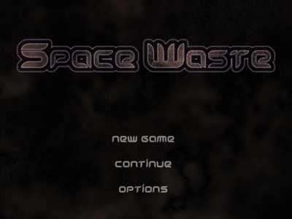
IO Games

Slide 3
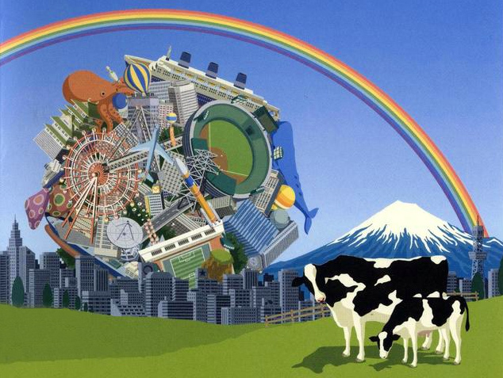
Influence
Biggest Influence: Katamari Damacy
Wanted to copy ‘object rolling’ mechanic
Physics-based gameplay
Light-hearted storyline: comical and borderline nonsensical
Came up with idea for Space Waste based on these criteria
Notes:
Explain what Katamari is briefly, some people might not know

Slide 4
Premise of Space Waste
Set about 50 years in the future
Earth has no more room to put its trash
Starts firing trash into space
Space rocket technology advances in a few years; allows for near light speed travel
But space is so full of trash that it’s dangerous to travel
World leaders establish a bureau responsible for cleaning up space: enter the player character!

Slide 5
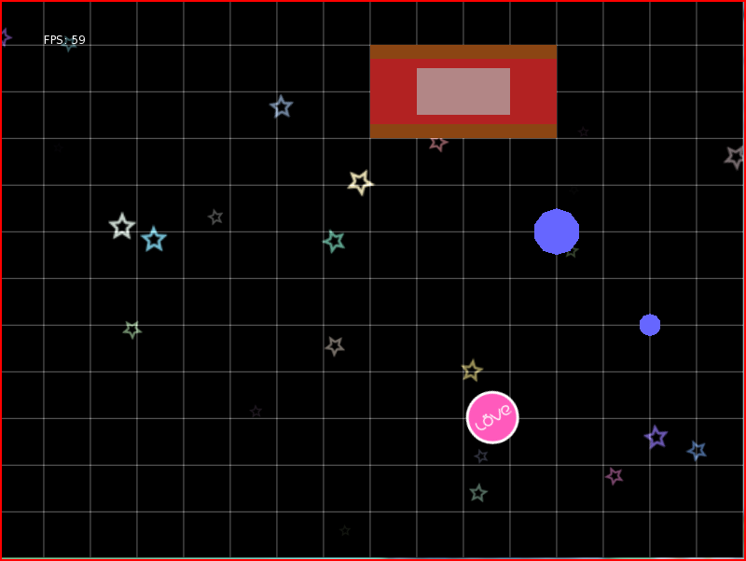
Pre-alpha: Game Engine LOVE
Pros of LOVE:
- Inherent physics engine
- Collision detection
- Intuitive keyboard to player controls
- Pretty colors
Cons of LOVE:
- Limited sound library
- Lack of flash integration
- Manipulation of too many objects
would slow frame rate
Notes:
LOVE: Physics engine, collision detection, intuitive keyboard-player interface

Slide 6
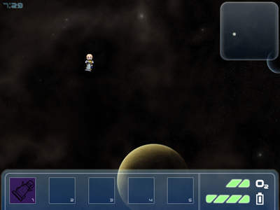
Alpha Release
The Good
- Artwork: player model,
background, HUD
- Key game mechanic is functioning
- Game physics ‘feel’ right
The Bad
- No progression yet: sandbox
- LOVE engine not entirely stable
- Hacked in sound and music;
frequently caused errors in sound

Slide 7
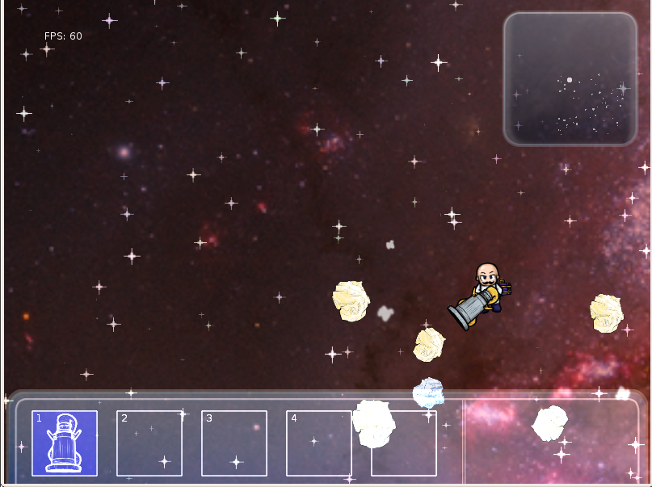
Beta Release
First stage is a two-part level, tutorial and pirate ship attack
Idea was to get the player acquainted with gameplay mechanics, then throw them into an exciting situation to get them hooked on the game
We found that players felt the difficulty of the game amped up way too quickly
Which led to our biggest difficulty in making this game: making it fun!

Slide 8
Golden Release
Don’t worry, the slide show is over.
We’ll show our demo now.

